Slide 1



Now Assist for ITSM
Workshop #1
November 7, 2025

Slide 2
Agenda
Review Boeing Current Mode of Operation of AI functionality
What's already installed (skills, Virtual agent?)
What have you tested
Review high level Now Assist offering (available skills)
Demo
Confirm which 3 skills we'll enable and configure
Quick assessment for the 3 skills
Next steps

Slide 3
ITSM Assessment Areas and Maturity
Current State Assessment
End User Experience (Portal/ Self Service)
Service Catalog
Knowledge Management
Enterprise Helpdesk
Level
Disparate portals exist, leading to fragmented user experience and disconnected fulfillment.
Built on Service Portal, not yet on Employee Center.
End user experience is very fragmented, static and not cohesive.
Level
Service Catalog Management process oversight is mature.
User experience and consumption of the catalog items for self-service/ support requests can be matured.
Level
Boeing’s Knowledge Management is highly mature and formalized
There are around 11,000 IT knowledge articles in the system, indicating a vast repository that covers a wide array of topics – a strength for self-service and support
Level
EHD supports multiple channels
Improvements are limited by fulfiller UI being outdated
Data extraction to support performance measures are manual and are performed using disparate systems.
2
4/1
4
2
Incident and Major Incident Management
Change Management
Problem Management
Intake and Release Management
Level
Boeing supports multi-channel incident intake
While the overarching incident process is consistent, each support team has the bandwidth to personalize procedures
MIM is at a higher maturity
Level
Practice is well-defined with three change types: Standard (pre-approved), Normal, and Emergency.
Changes are perceived to be the major cause of incidents
Module is significantly customized to support process
Level
Major problem management is mature, featuring structured workflows, evidence-based RCA, and clear accountability
The enterprise problem management process is inconsistent and team-driven, with low overall adoption of the problem module
Level
Boeing’s release management is thorough.
Release deployments are managed as formal events, often done after-hours or in maintenance windows.
The team is actively working on DPR, to enhance integration with ADO
3/ 3.5
2
2
3

Slide 4
Generative AI key concepts
Product
Usage
Skills
Individual use case capabilities for Now Assist, e.g. Incident/case Summarization, recommended actions
Actions
A set of instructions to accomplish a specific task, e.g. ‘Summarize this incident’
Models
The large language model (LLM) used to provide the foundation functionality, e.g. NowLLM, OpenAI
Assists
Currency for capturing the cost and value of the assist actions
Notes:
Explain
Consider the core concepts discussed on the slide. Each of them can have an implication on implementation.
Docs Links:
Full list of skills: https://docs.servicenow.com/csh?topicname=now-assist-skills.html&version=latest
NowLLM Model Cards: https://docs.servicenow.com/csh?topicname=reference-for-now-assist.html&version=latest

Slide 5
Example skills
Technology Workflows
Employee Workflows
Customer & Industry Workflows
Creator Workflows and Others
EXAMPLES
EXAMPLES
EXAMPLES
EXAMPLES
Incident overview summarization
Case summarization
Root cause analysis
Text-to-code
Chat and agent hand-off summarization
Resolution Notes Generation
Email composer generation
Employee skills growth
Recommended actions
Automated knowledge creation
Text-to-app
Flow Designer recommender
EXAMPLES
Enhanced search
Now Assist via domain-specific LLMs
Low-code configuration and analytics
further information see docs
Notes:
Explain
Here are some examples of skills available as part of Now Assist.

Slide 6
Core concepts for usage
Instruction
Action
Assist
Any communication where a human or system is providing guidance, input, or direction to a machine via the GAI Controller
A set of instructions to accomplish a specific task
Currency for capturing the cost and value of the assist actions (mapping between an action and its price tag per assist tier)
Examples:
Click “Summarize” button
//get incidents created yesterday
“It’s too long, make it shorter”
Examples:
Click “Summarize” button
//get incidents created yesterday
“Summarize this case”
> “Also add the resolution information”
> “It’s too long, make it shorter”
Each Action will use one or more Assists
More complex Actions will use more Assists
Notes:
Explain
Actions are activities that are that you can perform using generative AI (for example case summarization). Each action completed uses one or more assists.
The more complex an action is, or the higher value it has, the more assists will be used for each action.

Slide 7
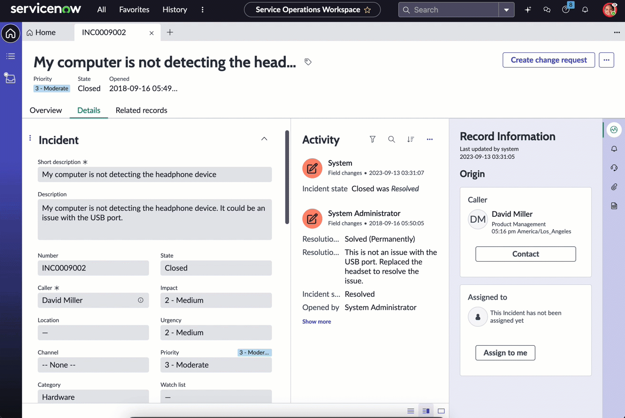
Now Assist panel
Now Assist panel
Overview
Accessible by agents within both UI16 and workspaces from the unified navigation bar.
Agents can ask the Now Assist panel to perform the following skills*:
Incident Summarization
Resolution Note Generation
see Now Assist for ITSM deployment guide for further details
Decision Required:
For features that support the Now Assist panel, will it be enabled or will you display capabilities in product?
Notes:
Explain
The now assist panel provides a natural language interface to access now assist features, similar to the experience with virtual agent. For compatible features, you can decide whether to enable the feature in product, in the Now Assist panel, or both.
In product will appear native to the core UI or workspace, at the time of need. For example for incident summarization, a ‘summarize’ UI action will appear at the top of the incident form, however you can also summarize an incident by opening the now assist panel and using natural language to request the incident be summarized.
Discuss
Would you like to use the now assist panel? What are the advantages/disadvantages to using either or both in your workflow?
Decision
Will you enable in-product/now assist panel or both in each Now Assist feature?

Slide 8
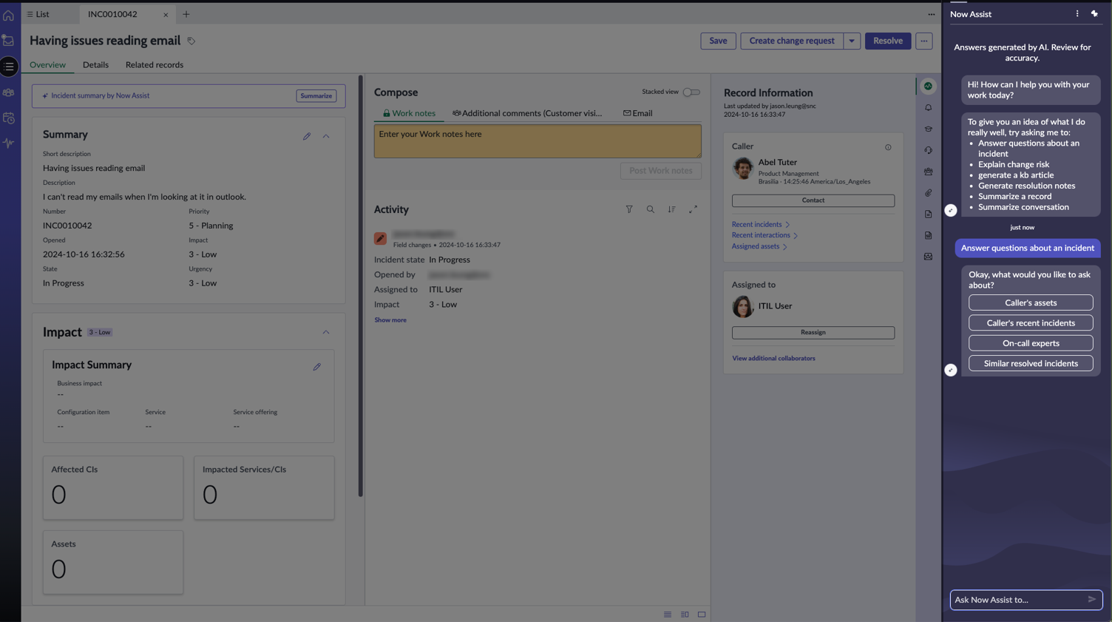
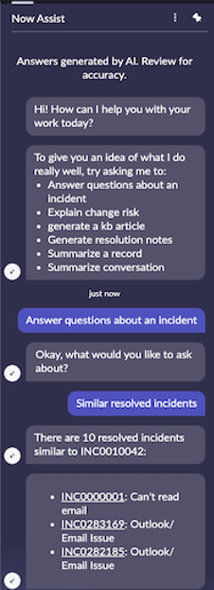
Now Assist panel Utilize the Now Assist panel to inquire about an incident
Now Assist panel
Overview
Efficiently gather common incident-related information by asking questions within the incident record using the Now Assist panel
Incident assist topics in the Now Assist panel include:
Caller's assets
Caller's recent incidents (within the past 7 days)
On-call experts from support groups
Similar resolved incidents
Notes:
Explain
The now assist panel provides a natural language interface to access now assist features, similar to the experience with virtual agent. For compatible features, you can decide whether to enable the feature in product, in the Now Assist panel, or both.
In product will appear native to the core UI or workspace, at the time of need. For example for incident summarization, a ‘summarize’ UI action will appear at the top of the incident form, however you can also summarize an incident by opening the now assist panel and using natural language to request the incident be summarized.
Discuss
Would you like to use the now assist panel? What are the advantages/disadvantages to using either or both in your workflow?
Decision
Will you enable in-product/now assist panel or both in each Now Assist feature?

Slide 9

Incident Assist
LLM Model: Now LLM
Supported in Now Assist panel: Yes
Supported in product (button): Yes
Efficiently gathers common incident-related information by asking questions within the incident record using the Now Assist panel.
Incident assist topics in the Now Assist panel include:
Caller's assets
Caller's recent incidents (within the past 7 days)
On-call experts from support groups
Similar resolved incidents

Slide 10
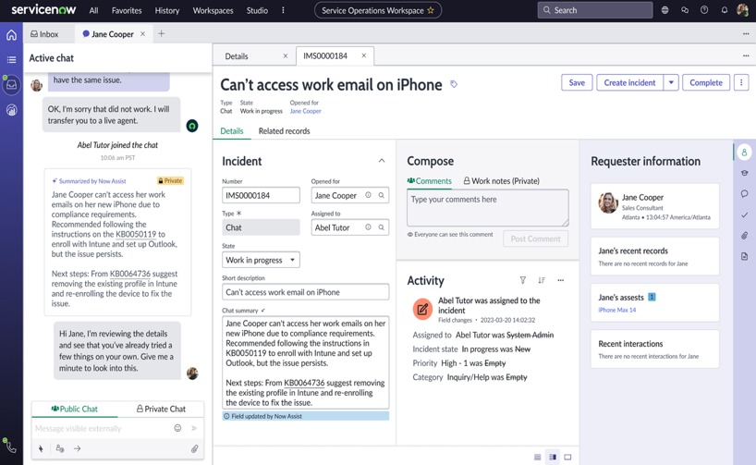
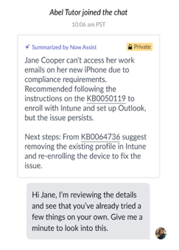
Chat summarization​
LLM Model: Now LLM
Supported in Now Assist panel: Yes
Supported in the product (button): Yes
Summarizes Troubleshooting Done by Virtual or Live Agent
Helpful for Agents Looking to Pickup Where the Virtual Agent Left Off
Reduces MTTR and Improves Experience

Slide 11
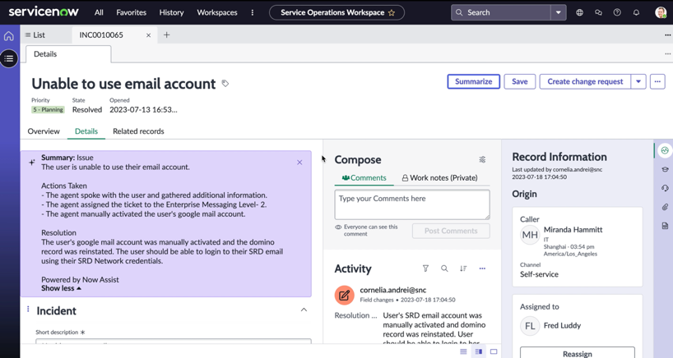
Incident summarization
LLM Model: Now LLM
Supported in Now Assist panel: Yes
Supported in product (button): Yes
Summarizes Troubleshooting Done by Previous Agent
Helpful for Agents Looking to Pickup Where the Last Agent Left Off
Reduces MTTR and Improves Experience
Notes:
Explain: Incident summarization allows you to summarize the details of an incident. It is useful for getting up to speed quickly on an incident with a detailed, complex or long history.
Discuss: Will this skill be enabled? 1 incident summarized = 1 assist. Additional fields can be added to increase the scope of summarization (Service Level Agreement, Affected CIs, Impacted Services, Child Incidents)
Decision: Will this be enabled, and what additional fields will you add as summarization inputs?

Slide 12
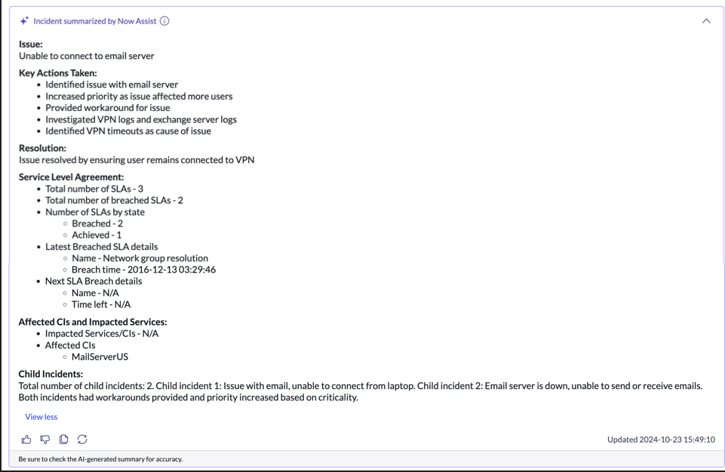
Incident summarization Core UI
LLM Model: Now LLM
Supported in Now Assist panel: Yes
Supported in product (button): Yes
Enhance the incident summary for your agents by incorporating additional details, including SLAs, affected Configuration Items (CIs), impacted services, and related child incidents
Notes:
Explain: Incident summarization allows you to summarize the details of an incident. It is useful for getting up to speed quickly on an incident with a detailed, complex or long history.
Discuss: Will this skill be enabled? 1 incident summarized = 1 assist. Additional fields can be added to increase the scope of summarization (Service Level Agreement, Affected CIs, Impacted Services, Child Incidents)
Decision: Will this be enabled, and what additional fields will you add as summarization inputs?

Slide 13
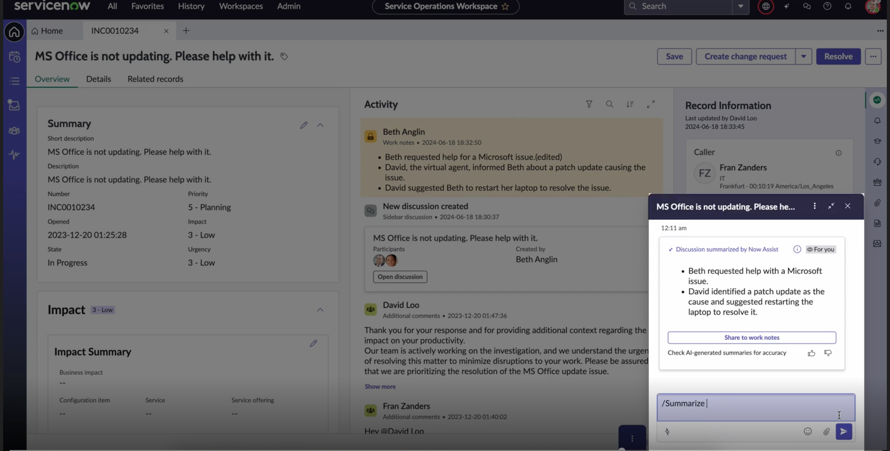
Sidebar discussion summarization
LLM Model: Now LLM
Supported in Now Assist panel: Yes
Supported in product (button): Yes
Lower Total Cost of Ownership
Increase Self Service
Reduces MTTR
Improved Service Quality

Slide 14
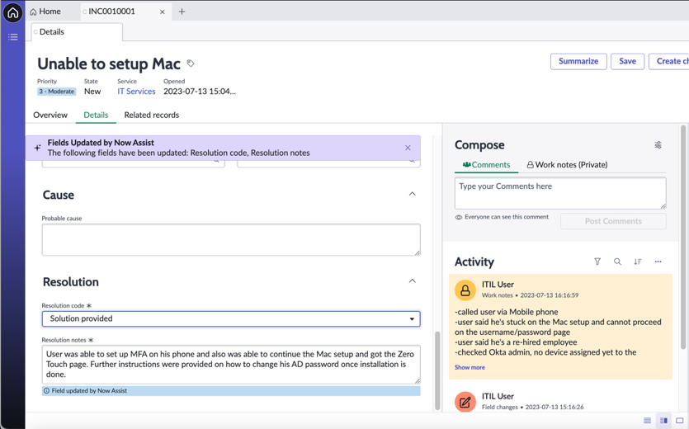
Resolution note generation
LLM Model: Now LLM
Supported in Now Assist panel: Yes
Supported in the product (button): Yes
Generates Resolution Notes and Code
Helps Agents Adhere to Best Practices
Increases Productivity and Improves Experience

Slide 15
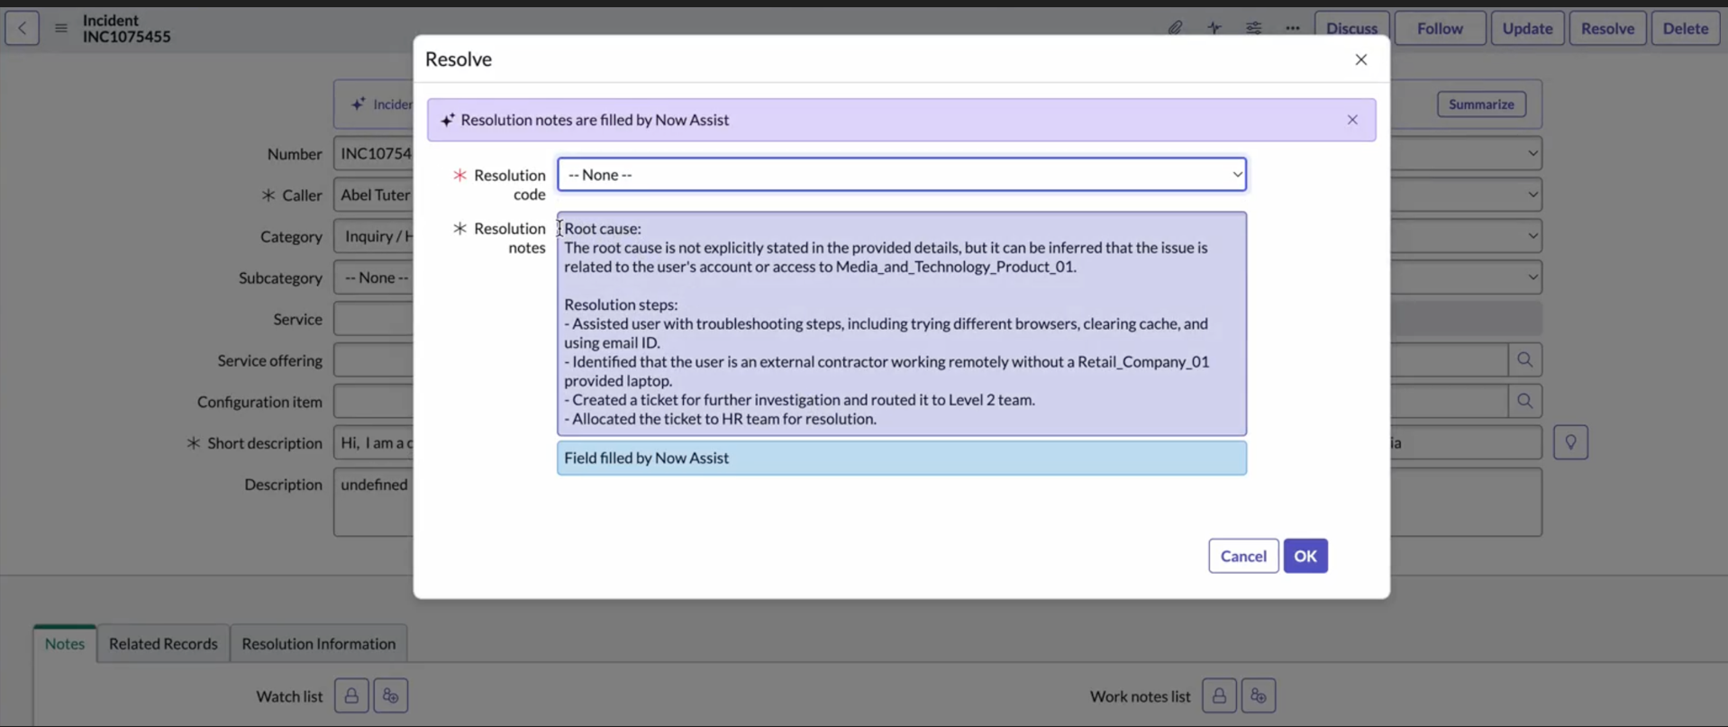
Resolution note generation
LLM Model: Now LLM
Supported in Now Assist panel: Yes
Supported in product (button): Yes
The Assist icon offers the following functionalities:
Generate resolution notes derived from the incident information
Refine the resolution notes by either elaborating on or condensing them

Slide 16
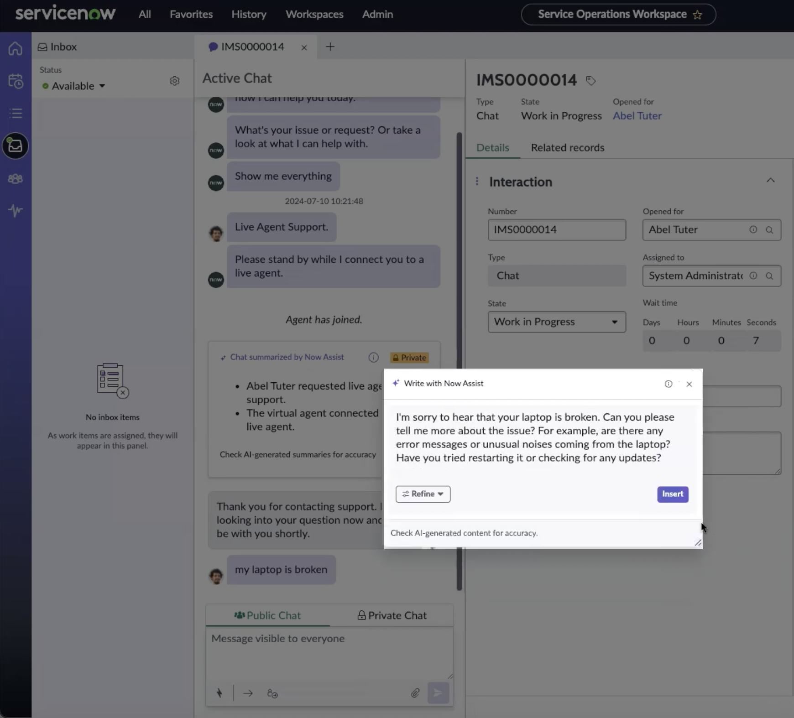
Chat reply recommendation
LLM Model: Now LLM
Supported in Now Assist panel: Yes
Supported in product (button): Yes
Generates a recommended reply that is based on the context of the conversation
Refines the recommendation by elaborating or shortening the response

Slide 17
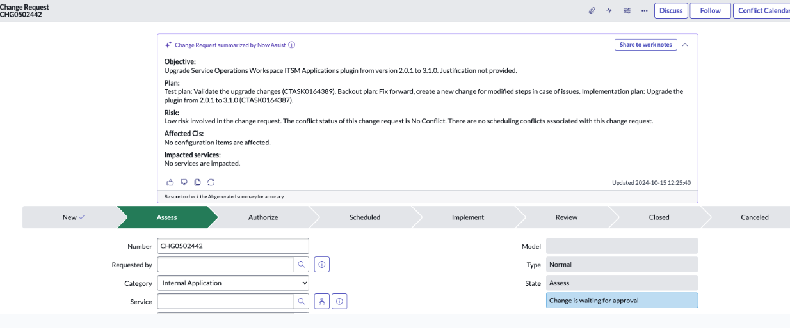
Change request summarization
LLM Model: Now LLM
Supported in Now Assist panel: Yes
Supported in product (button): Yes
Offers a concise summary of a change request
Captures the important details of a change request like Description, Risk, Impact, Work Notes, etc.

Slide 18
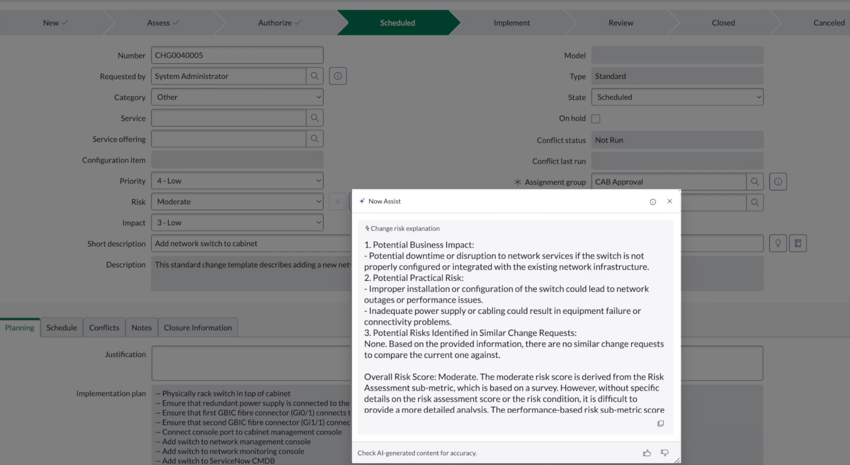
Change request risk explanation
LLM Model: Now LLM
Supported in Now Assist panel: Yes
Supported in product (button): Yes
Generates the explanation of the calculated risk rating for a change request
Data from the change request input table and additional inputs are used to justify the risk rating (high, medium, or low) of a change

Slide 19
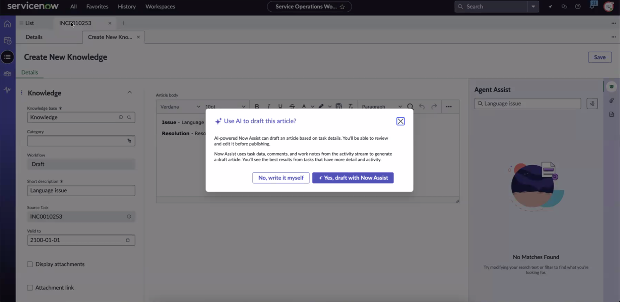
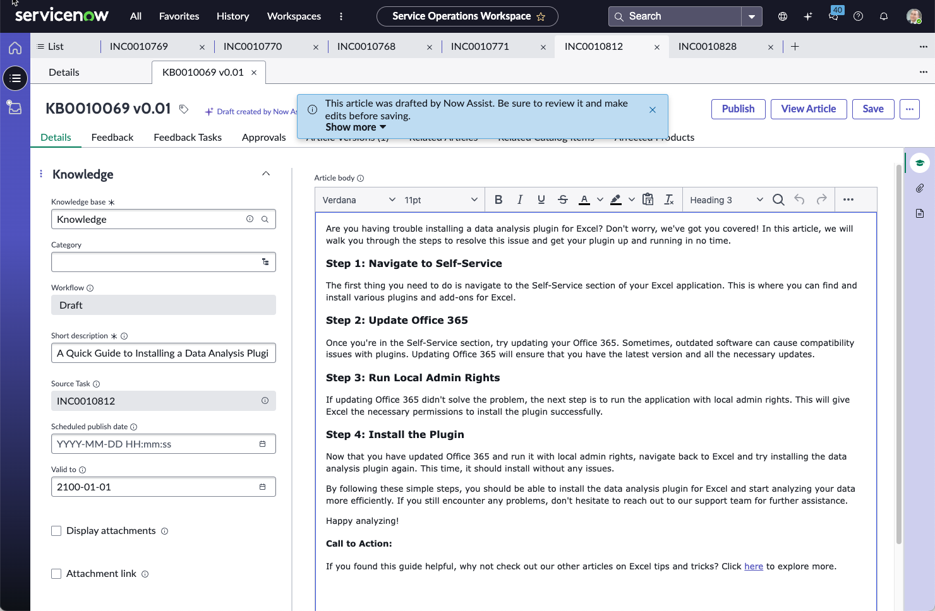
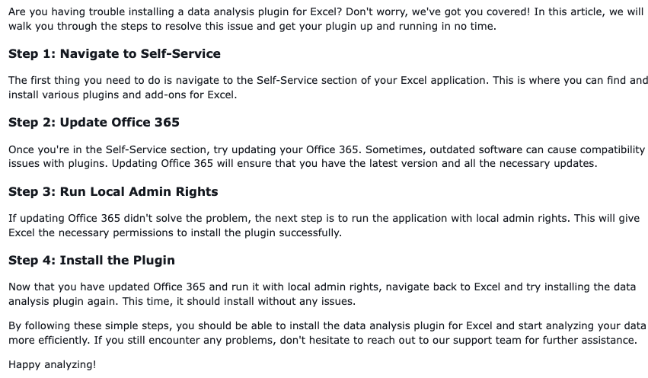
Knowledge generation from resolved incident
Generates Article Content for Review based on incident resolution details
Publish recommended knowledge articles generated by AI
Deflect incidents and increase uptime by scaling requestor self-service content
Notes:
Explain: You can generate a new knowledge article based on the resolution information from an incident by using the ‘create knowledge’ UI action. This can help where your organization struggles to create new & relevant knowledge articles.
Discuss: Do you wish to enable this skill? This skill is very useful for building relevant knowledge content, however there is a risk that it can cause proliferation of knowledge articles. This can be managed with a robust knowledge management process in your org.
Decision: Will you enable the skill?

Slide 20
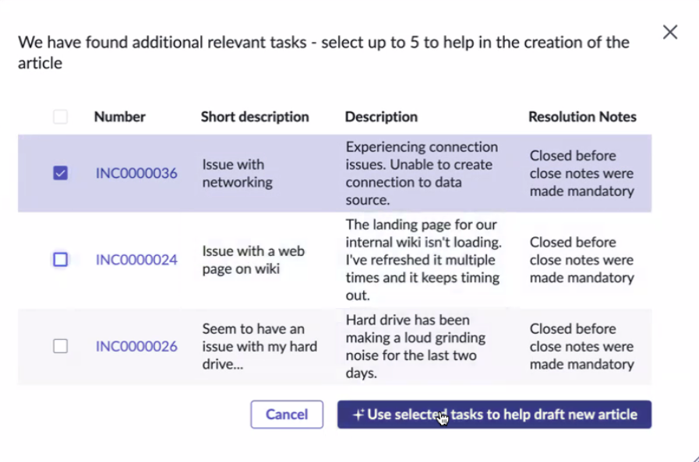
Knowledge generation from resolved incident
When drafting the article using Now Assist, a user can select up to five relevant tasks to assist in its creation
After making your selections, click 'Use selected tasks to help draft new article.' If you do not wish to proceed, click 'Cancel’
"When compiling an article that encompasses information from multiple similar incidents, a single article is generated, incorporating details from the chosen incidents

Slide 21
Demo
To be demonstrated
Now assist panel
Skills

Slide 22
Decision time
Align on which skills should be configured
Keep in mind that agents Phoebe and Elara agents will be deployed, taking care of knowledge and closing of incidents
Chat summarization within interaction record
Major incident summarization
Bryan to provide examples.
Knowledge summarization against Q&A for the fulfiller aligned with Boeing customized knowledge (hold for now, include in the roadmap)

Slide 23
Assessment
 | Answers
Are there additional input fields that would facilitate summarization?
Are Short Description and Description fields out-of-box?
Are State choice values out-of-box?
Is the Resolution workflow out-of-box or are there any customizations around task resolution to be aware of?
Are the agent roles out-of-box or are any custom roles used that need to be factored in?
Is the plan to move all agent to Next Experience UI? I.e. newest workspace? If so, when?

Slide 24
Deliverables, Exclusions and Assumptions
Deliverables:
Phoebe and Elara Agentic Agent Accelerators (as identified by approved use cases)
Workshop next week
ITSM Now Assist deployment in sub-production environment for POC testing
Exclusions:
Production deployment and post-production support
Customization of NewRocket Agents or Now Assist features
Development of custom AI or Large Language Models (LLM)
Implementation of ServiceNow modules beyond advisory related to the current implementation (ITSM Now Assist).
Data cleansing or improvement of existing incident records or knowledge articles
Development of custom integrations to any third-party systems
Re-training of the underlying ServiceNow LLMs
Assumptions:
Base ITSM applications are implemented, configured and operations.
This POC will leverage the LLM provided by ServiceNow through the Now Assist product.
Boeing will provide a Project Manager to collaborate with the NewRocket Project Manager
Boeing will provide clear and timely feedback
Boeing will provide clear business goals during the Initiate stage of the engagement
Boeing will provide NewRocket resources with access to non-production environments in support of this program prior to development activities starting

Slide 25
Next Steps
Coordinated instance and access plan
Upcoming Workshops
Value Realization Dashboard Deep Dive
Demoing Phoebe and Elara (NR Agents)
Integrations Evaluation and Recommendations
Stories refinement and sign off
Boeing AI Roadmap Maturation (schedule later)
Create outstanding stories based on approved configuration
Review stories and provide feedback or acceptance of stories
Configuration can begin

Slide 26


